Slide 1
Vision based recognition of pole vault phases: plant, take-off, swing, turn and fly away (CV CP PID- 16)
Vishwakarma Institute of Technology, Pune
STUDENT CONFERENCE
Computer Vision – TY D 2022
Authors:
Prof. Jyoti Madake, Sagar Suryawanshi, Suyash More, Dr. Shripad Bhatlawande
Department of E&TC Engineering

Slide 2
Introduction
Literature Survey
Research Gap
Novelty
Methodology
Results
Advantages and Limitations
Conclusion
Contents

Slide 3
INTRODUCTION:
What is Pole Vault Sport?
Need to detect Phases of pole vault
Challenge to Detect Different phases and Track the athlete
Proposed System Helps in performance enhancement

Slide 4
LITERATURE SURVEY

Slide 5
Vision-based action recognition of construction workers[1]
Recognizing construction worker actions based on video footage using dense trajectories
Includes 11 different types of actions performed by 10 workers.
SVM Accuracy of 84.7%
Human action recognition with sparse geometric features[2]
Propose a new feature extraction method based on sparse coding and geometric feature representation.
KTH dataset : 96.3%
Weizmann dataset: 96.7%
UCF Sports dataset : 87.8%
Human physical activity recognition [3]
Six different types of activities, such as walking, jogging, and jumping.Indoor obstacle detection
CNN for features and LSTM for the classification
93.8% accuracy.

Slide 6
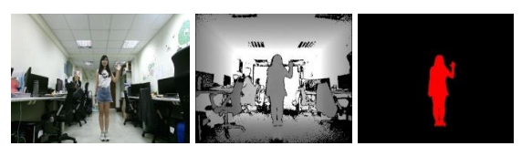
Companion Robots and
Human Interaction[3]
The system is divided into three parts: motion map construction, feature extraction, and human action classification.
Accuracy of 93.67%.
A dual stream model for activity recognition[5] Introduces a dual stream model for human activity recognition using a combination of residual convolutional neural network (ResNet) and transfer learning. UCF-101 : 96.13% HMDB-51 : 72.34%
HRI in industrial applications. [6]
Uses a combination of skeleton-based and appearance-based features to represent human actions.
An accuracy of 94.5%

Slide 7
Limited Dataset
Obstruction
Research Gap
Variability in technique
Real-time recognition
Transferability

Slide 8
Multi-view recognition
Deep learning approaches
Novelty
Joint recognition of athlete and pole
Transfer learning
Real-time pose estimation

Slide 9
METHODOLOGY

Slide 10
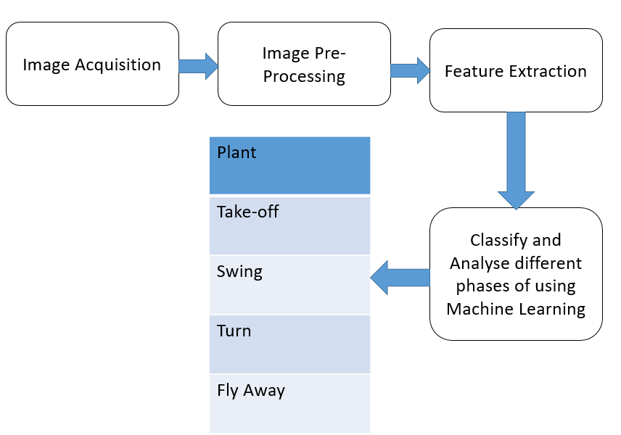
System Block Diagram

Slide 11
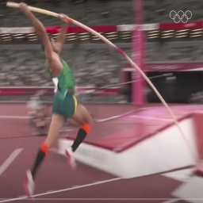
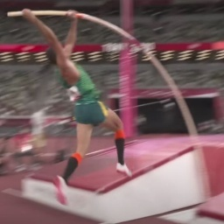
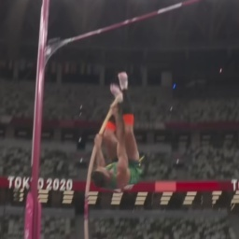
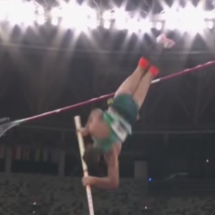
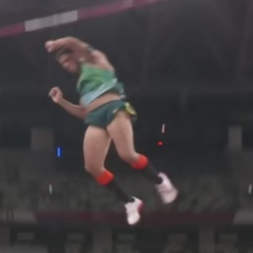
Dataset Samples
Plant
Takeoff
Swing
Turn
Fly Away

Slide 12
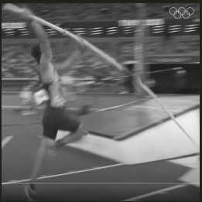
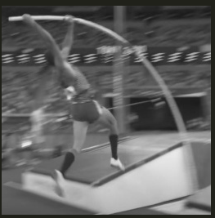
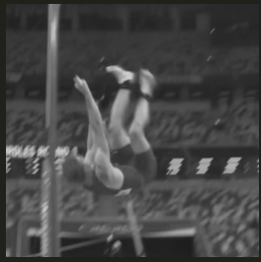
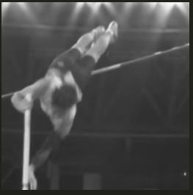
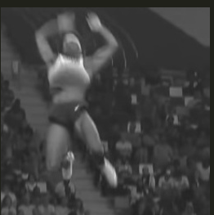
Processed Images
Plant
Takeoff
Swing
Turn
Fly Away

Slide 13
Dataset and Preprocessing:
Dataset consists of 1431 RGB images.
Every image is resized to 256x256 pixels.
Images converted to grayscale
Pole vault phase | Action Sequence | No. of Frames
Plant | 1 | 226
Take off | 2 | 244
Swing | 3 | 346
Turn | 4 | 372
Fly away | 5 | 243

Slide 14
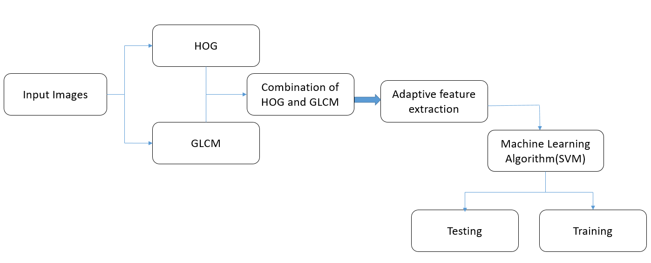
Feature extraction:

Slide 15
Features and Classification
Shape of GLCM Features : 1431 x 48
Shape of HOG Features : 1431 x 34596
Shape of Combined HOG + GLCM : 1431 x 34644
SVM classifier to predict the class labels of a dataset
SVM Kernel = Linear

Slide 16
Classifier | Accuracy detected
SVM | 0.895
Decision Tree | 0.672
Random Forest | 0.770
KNN | 0.515
Classifier Testing and Analysis

Slide 17
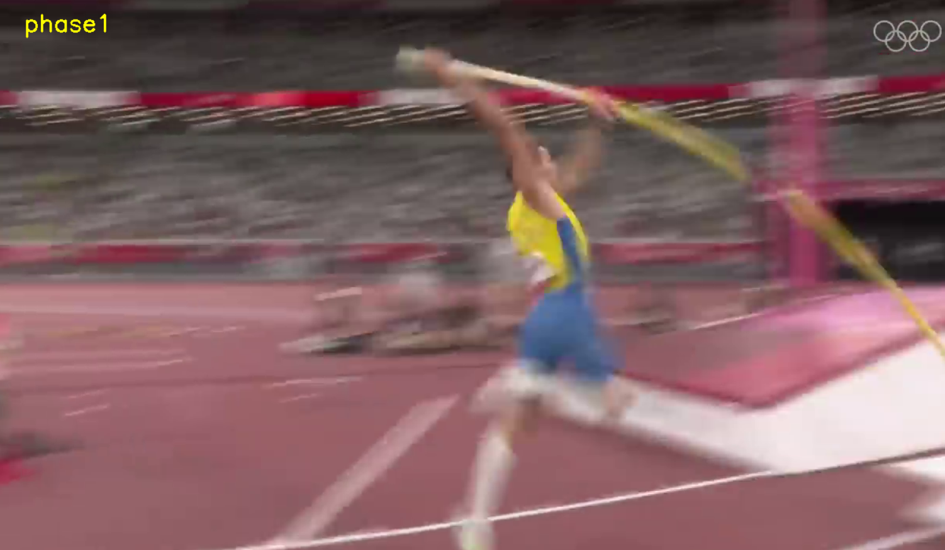
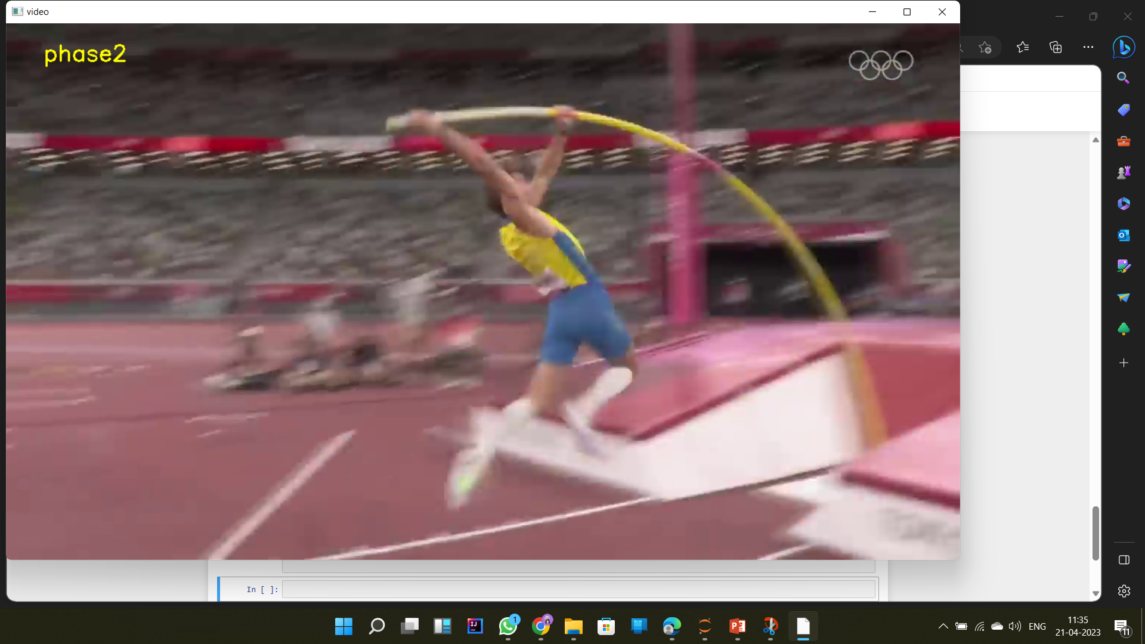
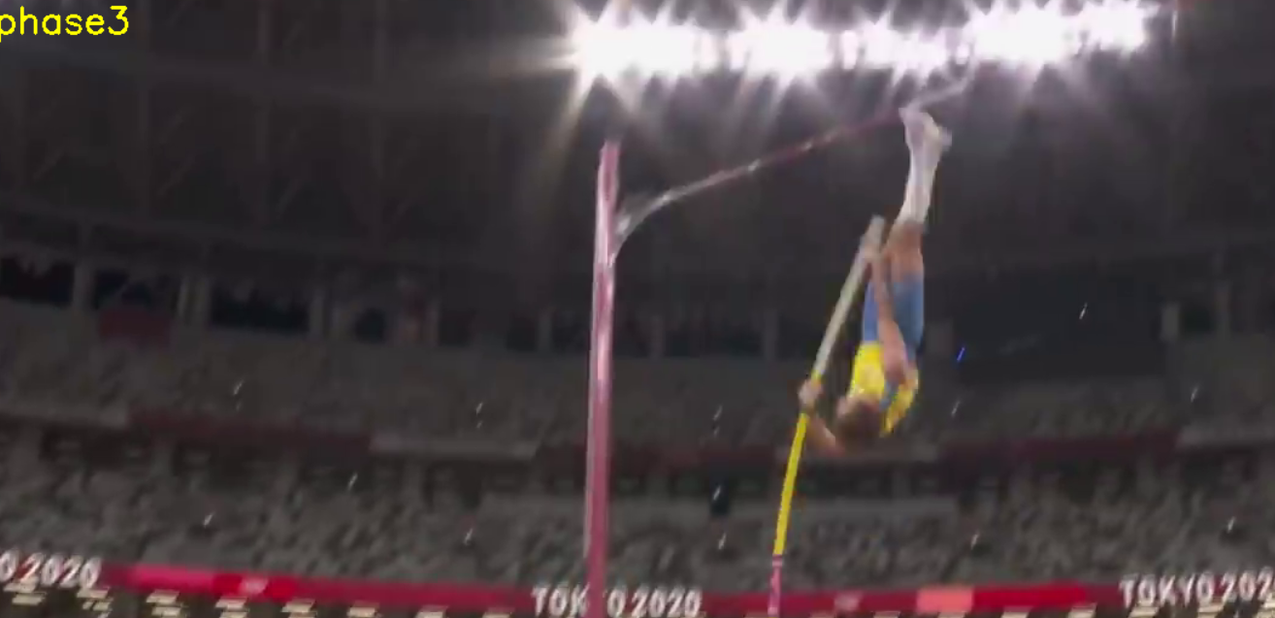
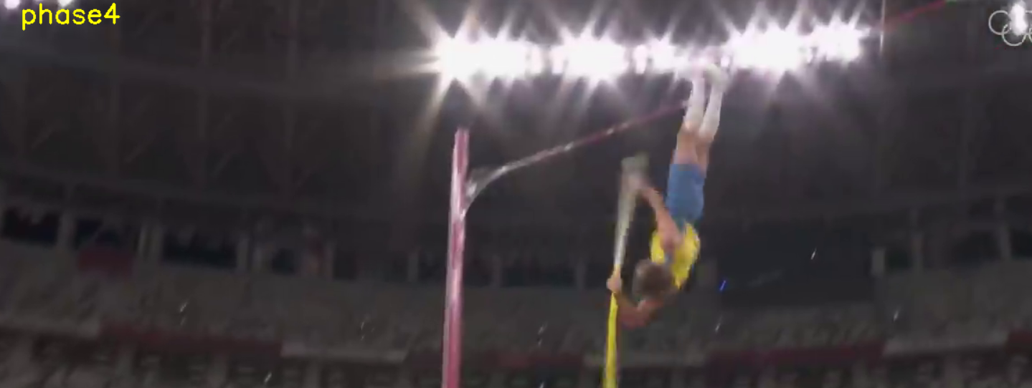
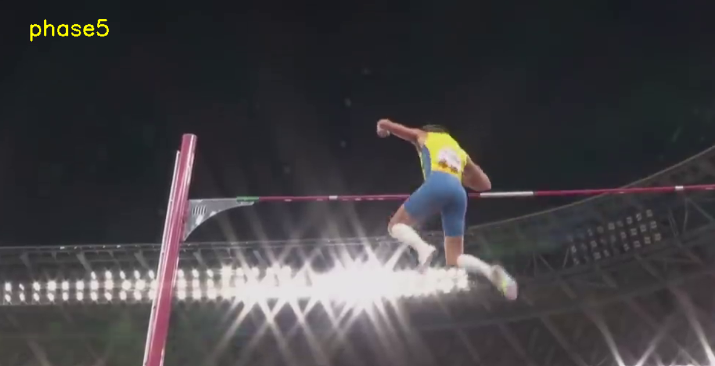
Results
Plant
Takeoff
Swing
Turn
Fly Away

Slide 18
Testing Analysis

Slide 19
Advantages
Limitations
Able to classify Different phases of pole vault
Accuracy: 89.55%
Portable & Lightweight system
Cost effective
Blurred or noisy input images can leads to wrong prediction.
Could not predict smooth transition between phase change

Slide 20
Provides the user with a thorough understanding of the pole vault phases.
Can accurately classify the phases of the pole vault
Accuracy: 89.55%.
Lightweight, efficient and cost effective solution.
Conclusion

Slide 21
References:
Yang, Jun, Zhongke Shi, and Ziyan Wu. "Vision-based action recognition of construction workers using dense trajectories." Advanced Engineering Informatics 30, no. 3 (2016): 327-336.
Han, H., and X. J. Li. "Human action recognition with sparse geometric features." The Imaging Science Journal 63, no. 1 (2015): 45-53.
Chiang, Meng-Lin, Jian-Kai Feng, Wen-Lin Zeng, Chiung-Yao Fang, and Sei-Wang Chen. "A vision-based human action recognition system for companion robots and human interaction." In 2018 IEEE 4th International Conference on Computer and Communications (ICCC), pp. 1445-1452. IEEE, 2018.
Mo, Lingfei, Fan Li, Yanjia Zhu, and Anjie Huang. "Human physical activity recognition based on computer vision with deep learning model." In 2016 IEEE international instrumentation and measurement technology conference proceedings, pp. 1-6. IEEE, 2016.

Slide 22
5. Singh, Roshan, Rajat Khurana, Alok Kumar Singh Kushwaha, and Rajeev Srivastava. "A dual stream model for activity recognition: exploiting residual-cnn with transfer learning." Computer Methods in Biomechanics and Biomedical Engineering: Imaging & Visualization 9, no. 1 (2021): 28-38.
6. Akkaladevi, Sharath Chandra, and Christoph Heindl. "Action recognition for human robot interaction in industrial applications." In 2015 IEEE International Conference on Computer Graphics, Vision and Information Security (CGVIS), pp. 94-99. IEEE, 2015.

Slide 23
THANK YOU

